Slide 1


Web-Controlled Robot Arm
Antonio Tinnon & Madison Galloway
Mentor: Professor Kohn

Slide 2
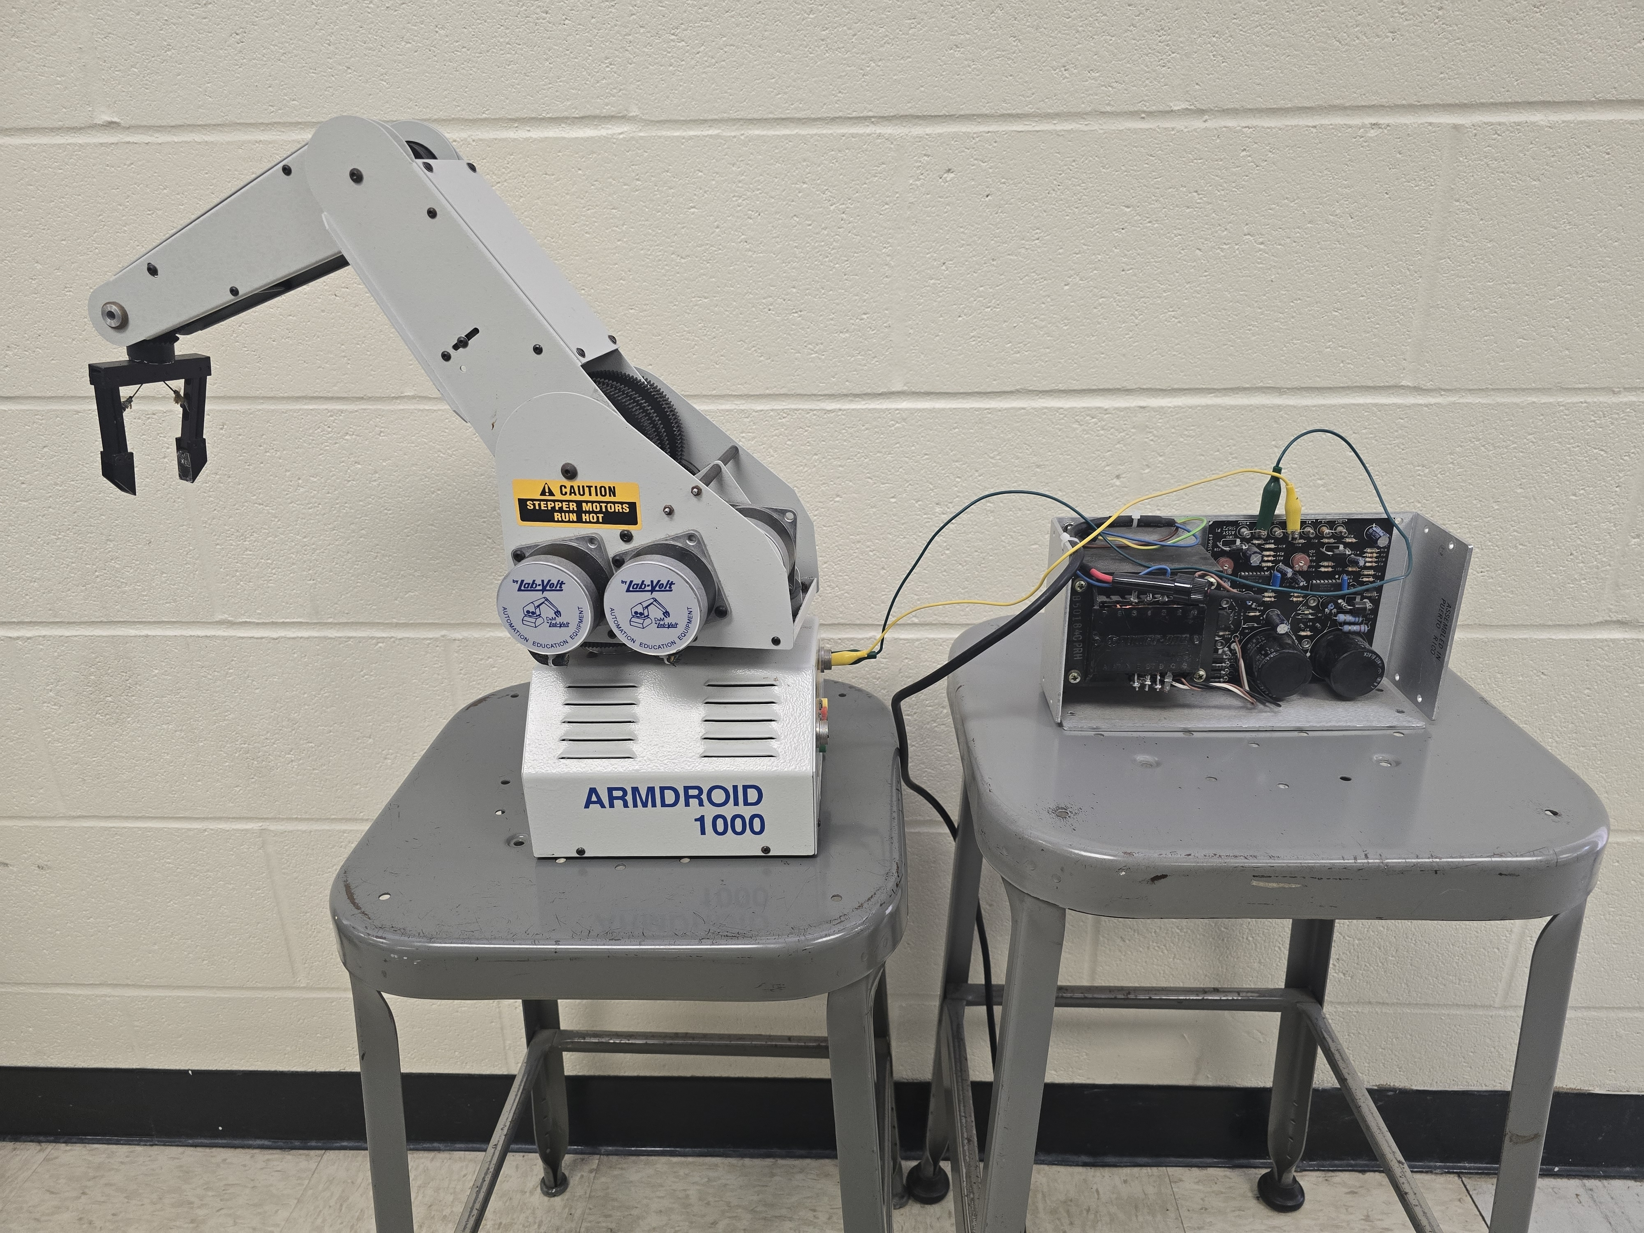
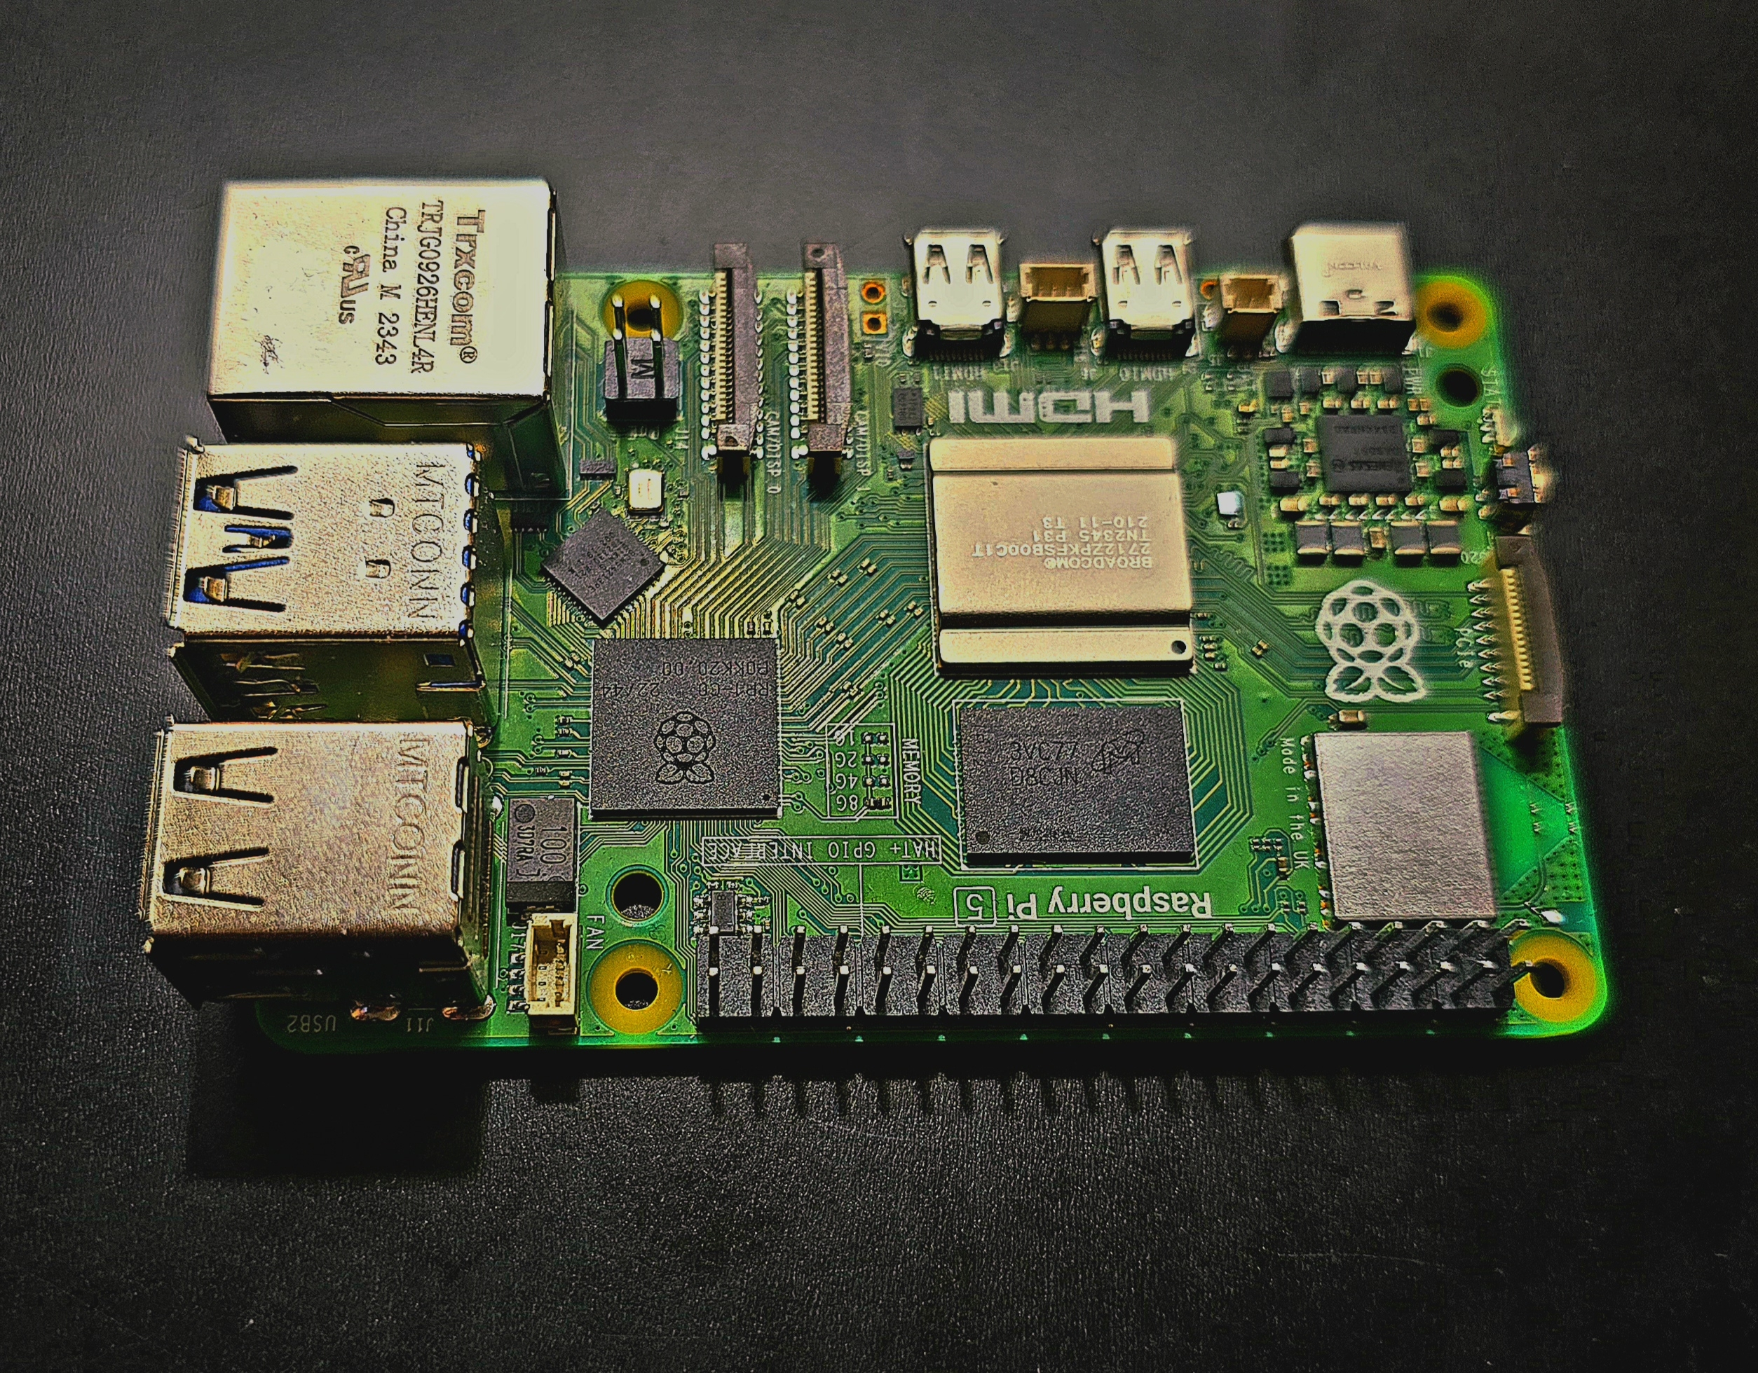
Project Overview
LabVolt Armdroid 1000
Raspberry Pi
Web Server
Python
Website
HTML
CSS
JavaScript

Slide 3
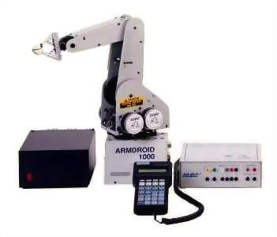
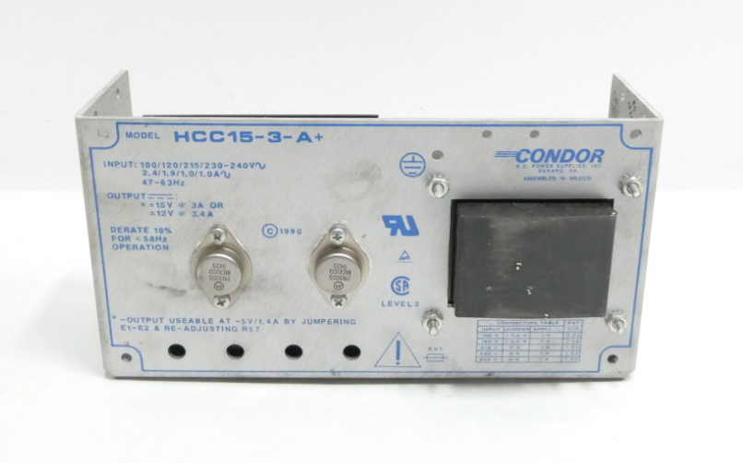
LabVolt Armdroid 1000
LabVolt Armdroid 1000
Is a robot arm that has 5 axis and has 6 stepper motors. The motors take up to 200 steps per revolution for each motor. The robot arm comes equipped with either a 120- or 220-Volts power supply to operate, and a teach pendant to operate.
Condor HCC15-3-A DC power supply

Slide 4
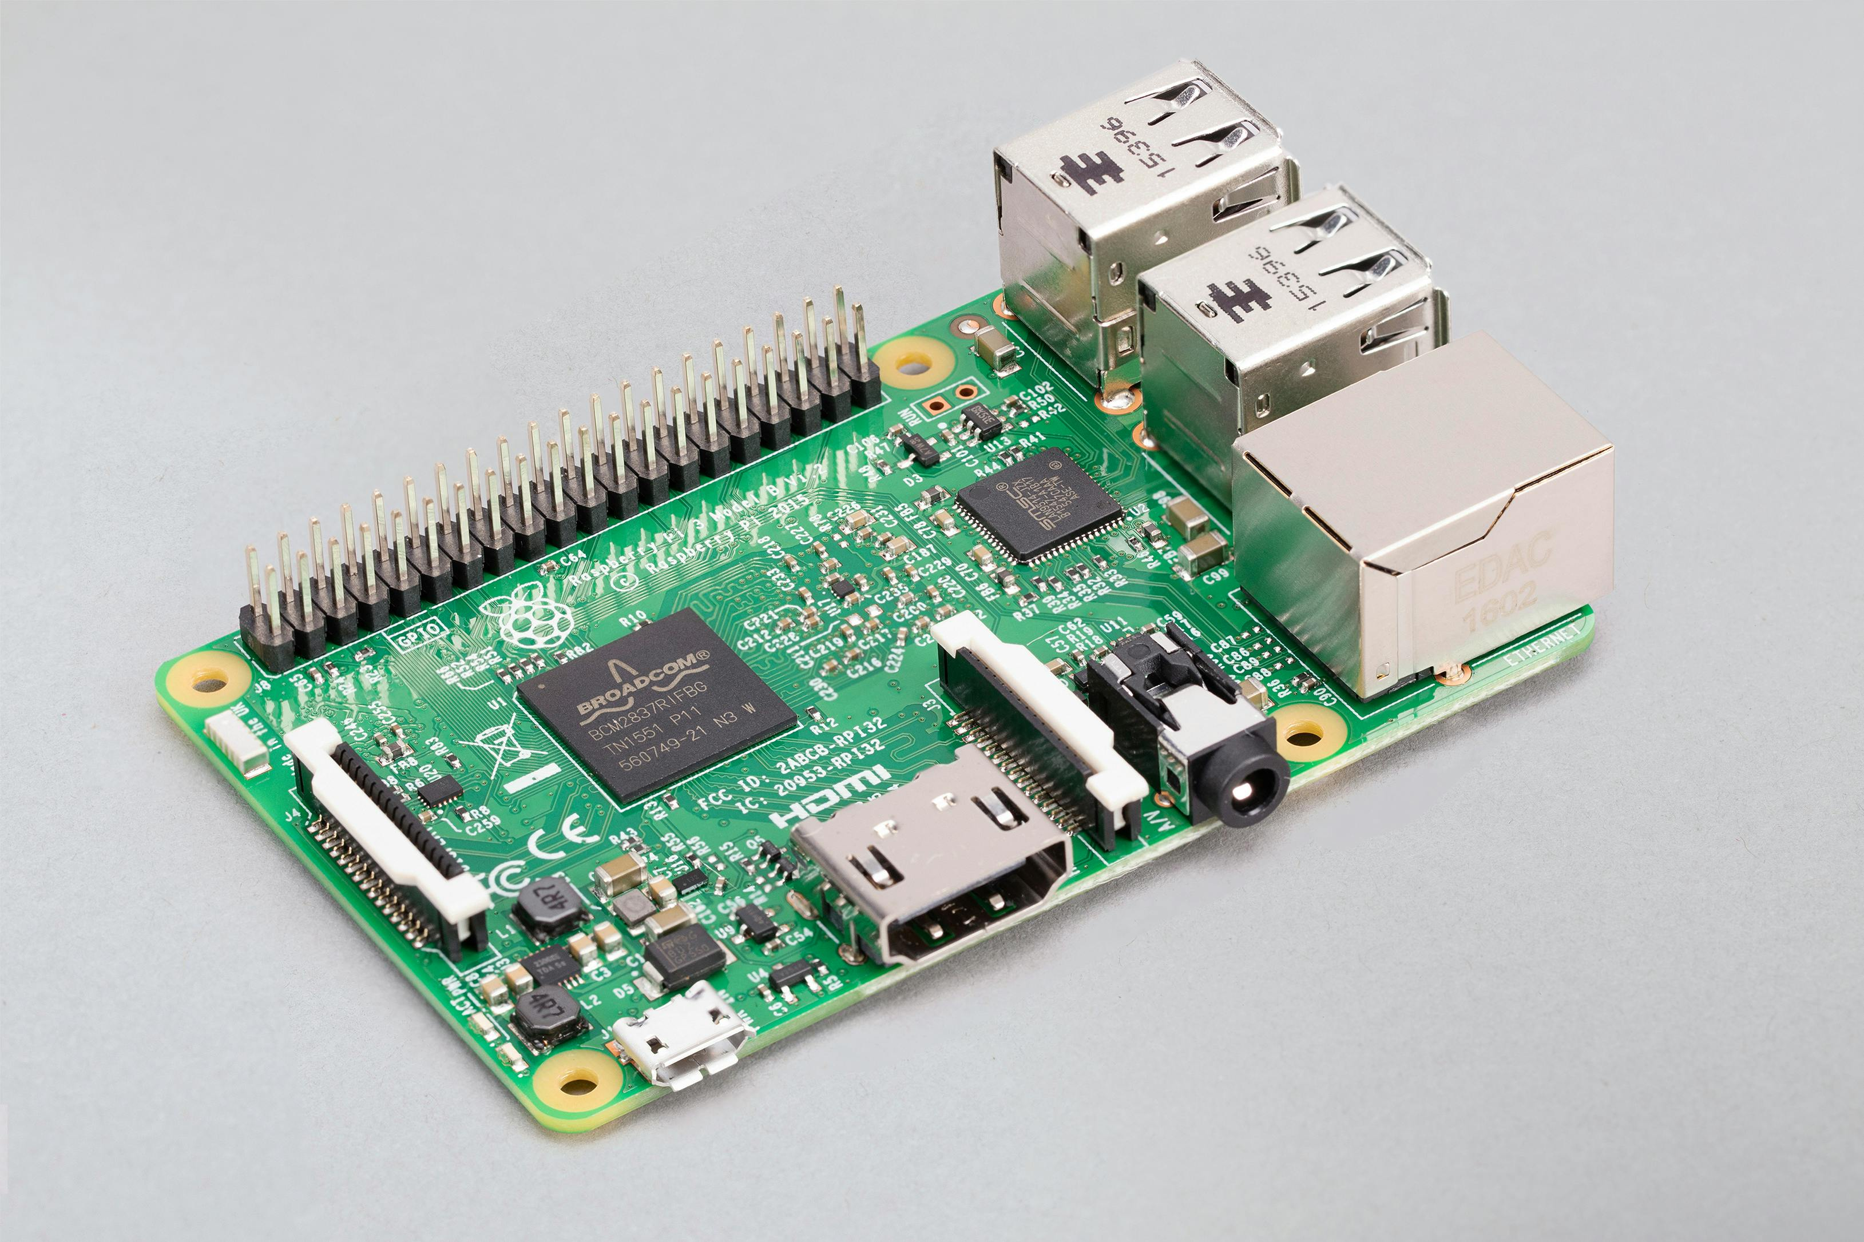
Raspberry Pi
Raspberry Pi
The Raspberry pi acts as the brains for the project. It is a small, low-cost, single-board computer. It has wireless internet connectivity, HDMI and USB ports.
We used both Raspberry Pi 3 Model B and Raspberry Pi 5 for this project.

Slide 5
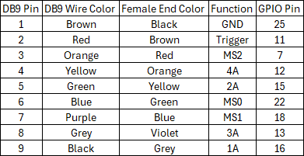
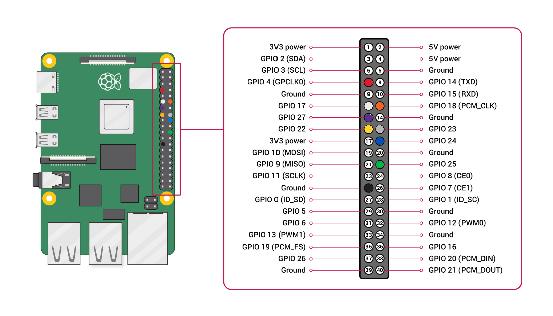
Web Server
Raspberry Pi
Flask
General purpose input/output (GPIO)
Python
Robot arm code inputs

Slide 6
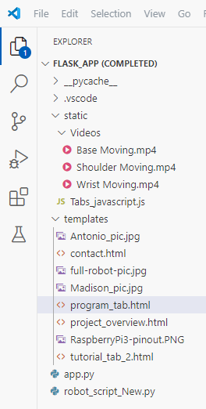
Website’s Structure
Different Pages/ Tabs
Project Overview
Tutorial
Programming
Contact
HTML & JavaScript

Slide 7
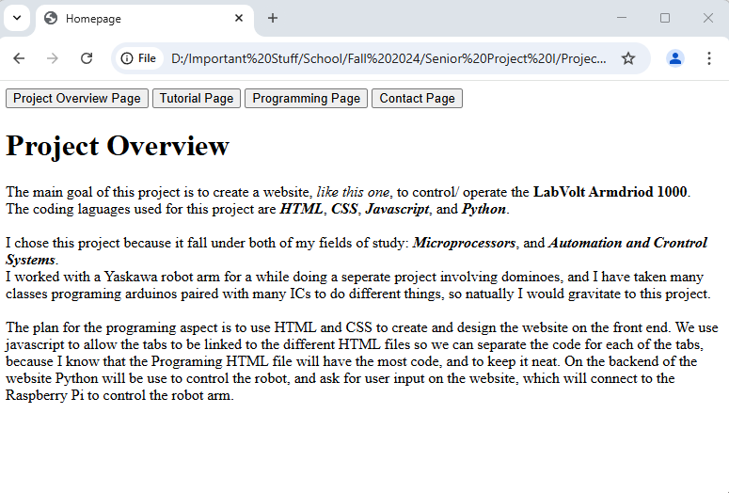
Website’s Structure
Impact of CSS

Slide 8
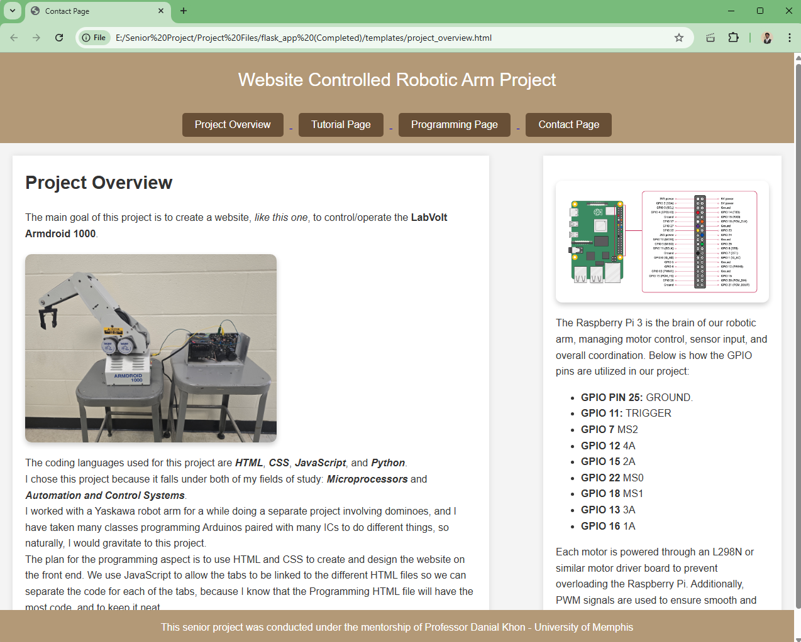
Website’s Structure
Impact of CSS

Slide 9
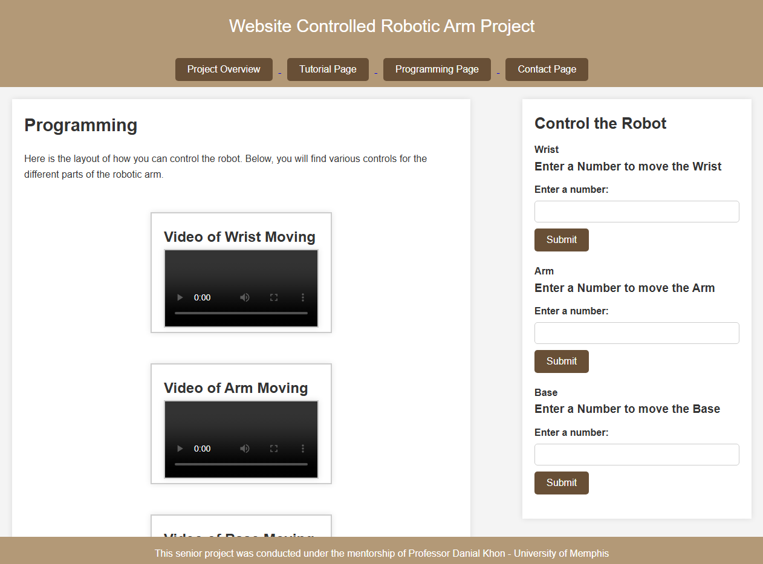
Website’s Structure

Slide 10
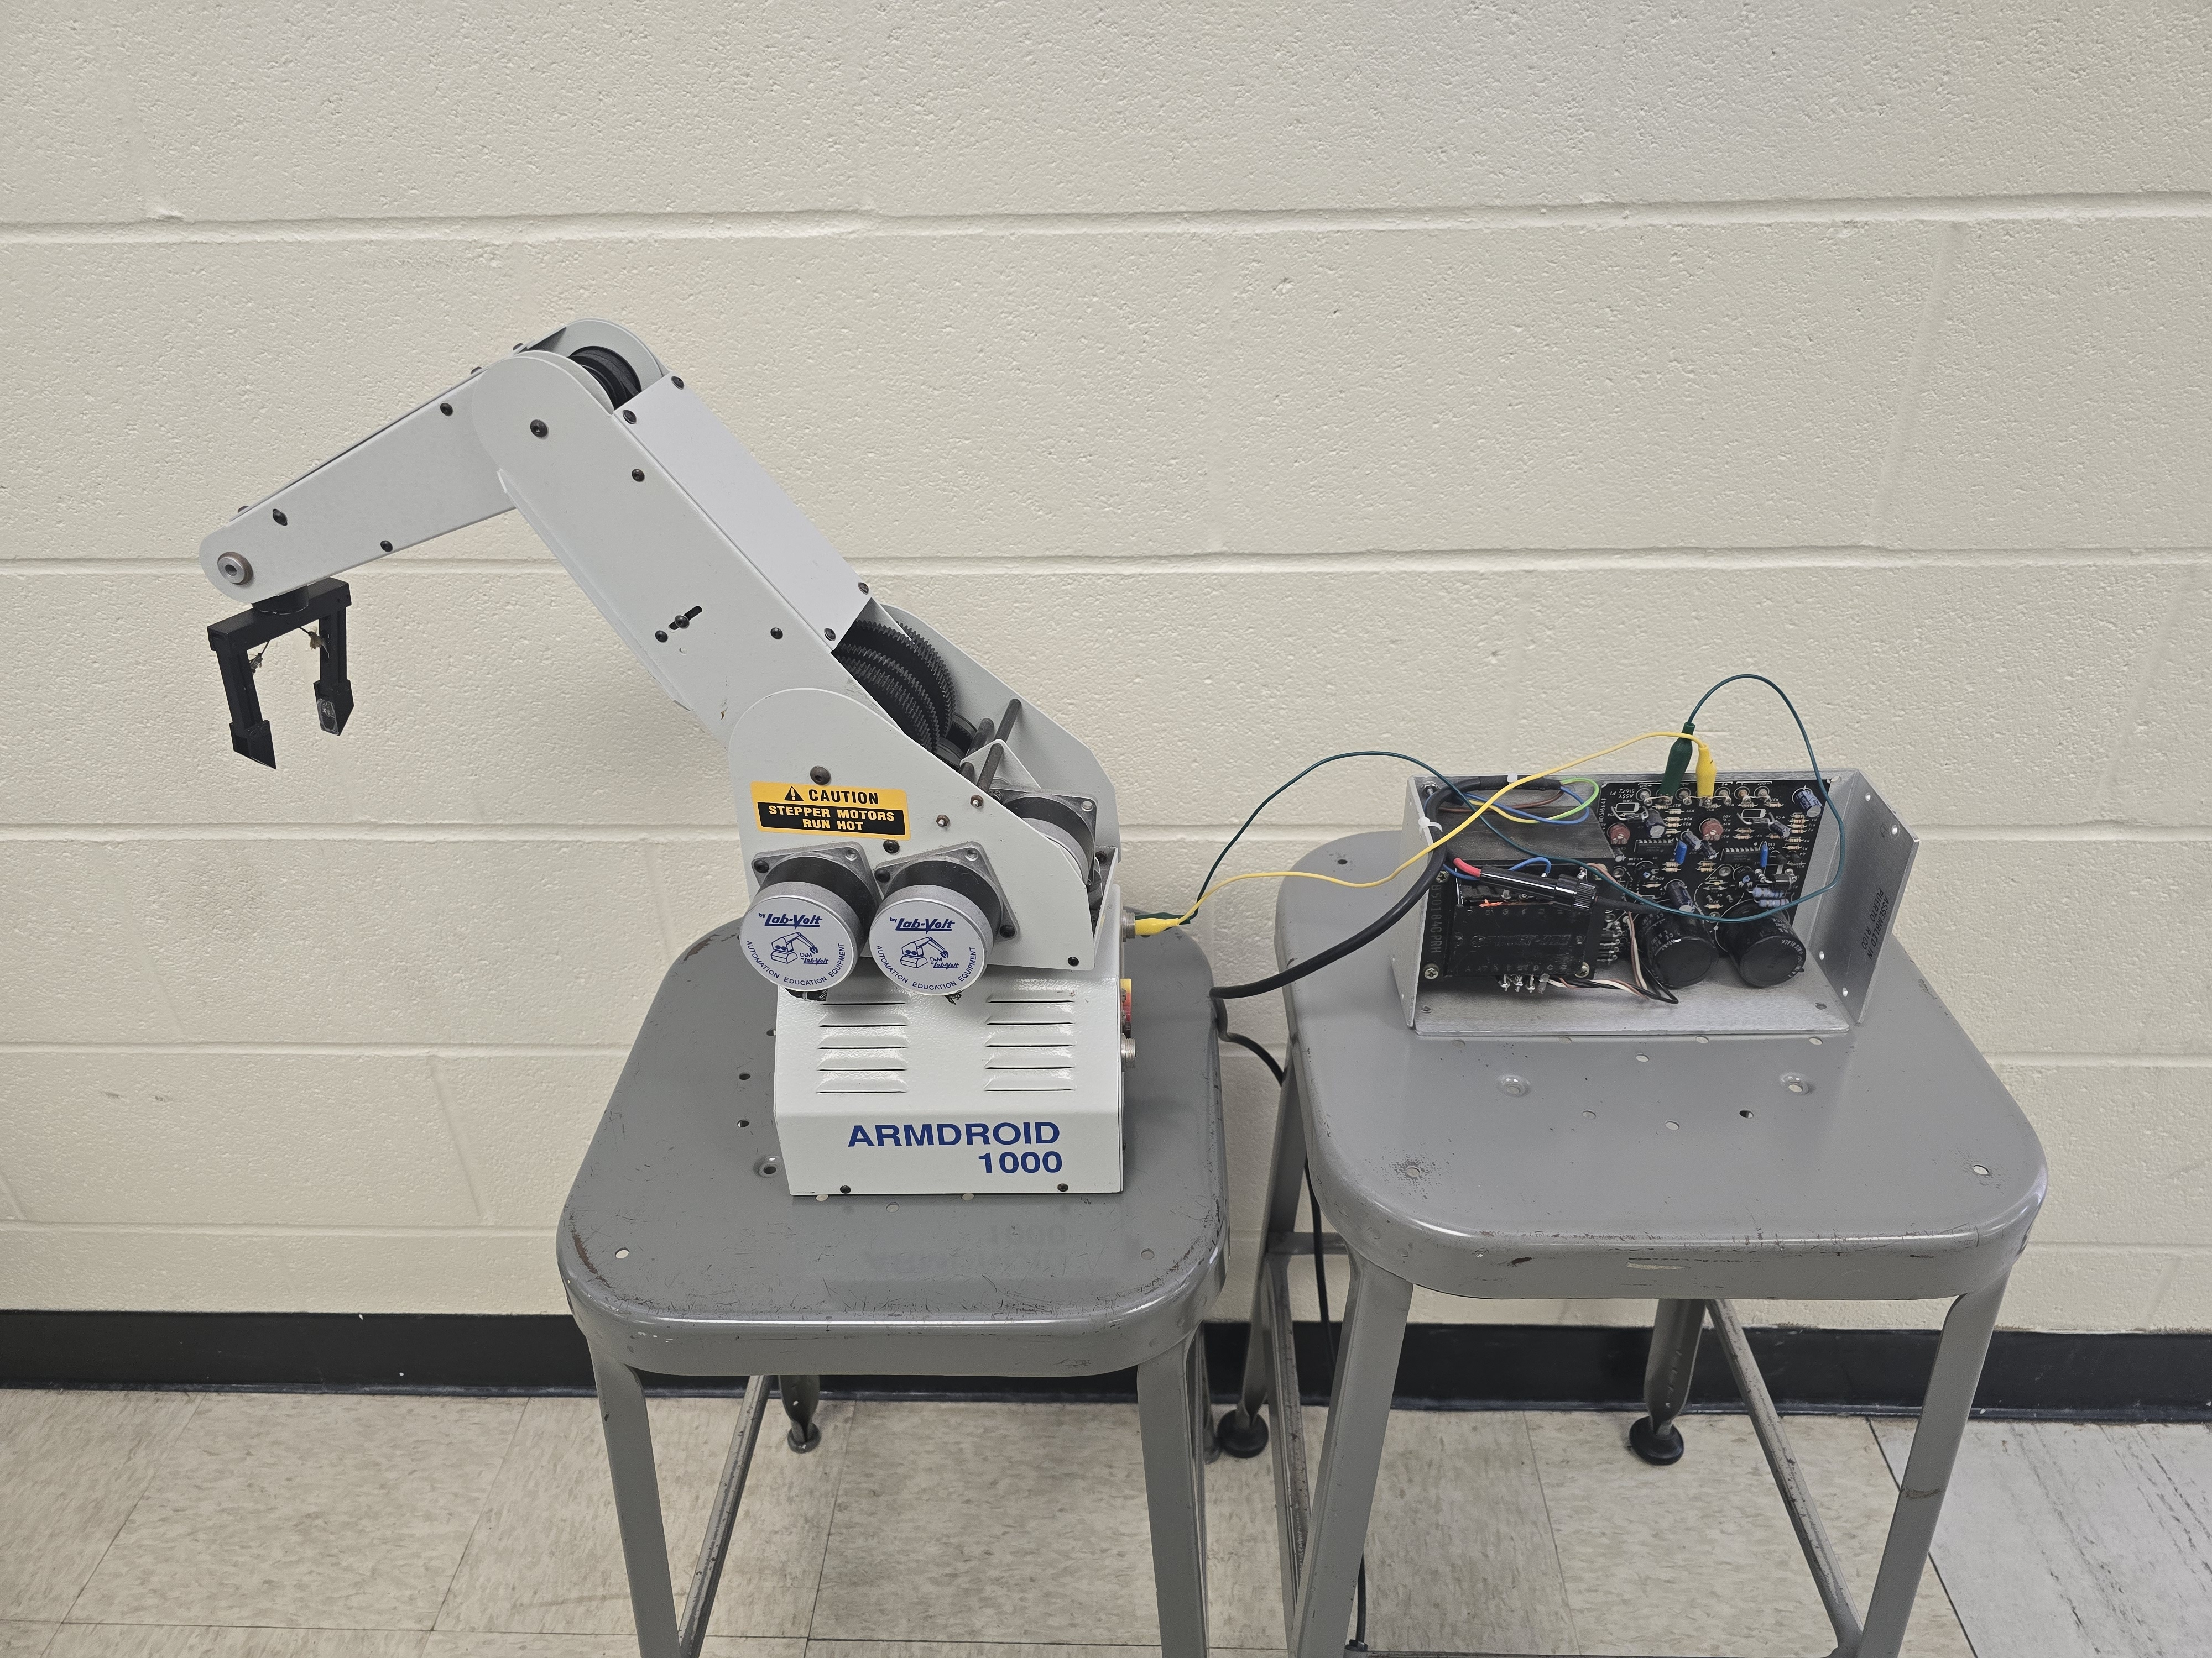
Conclusion
Develop Website
Develop Web Server
User Input

Slide 11

YouTube
YouTube QR Code & Link
https://www.youtube.com/watch?v=KIYbYtsxWqs

Slide 12




Questions and Answers
Thank you
Do we have any questions?
LinkedIn Profiles:
1Antonio Tinnon
Madison Galloway

